Slide 1
Steering Committee Regional Group training

Slide 2
A few simple guidelines
As we begin the training session, please follow a few basic guidelines to ensure productive results:
Be present by silencing all cell phones and put them to the side, face down.
Ask questions as they arise! (Please no side conversations)
We will have a “Parking Lot” for ideas that need further discussion.
Think in terms of your role as a Steering Committee Member; responsible for the well-being and future of this organization.

Slide 3
Topics
Introductions & Steering Committee Training
Why Are We Here
Mission of NEWH
Responsibilities of the Steering Committee
Steering Committee Roles
Review Member Survey
SGOT Analysis
Strengths
Gaps
Opportunities
Threats
Breakouts (ideas) – Programming, Membership, Marketing, Scholarship
Breakout Report Back
Review NEWH Website
Wrap Up & Adjourn

Slide 4
Why are we here?
Knowledge is POWER!
NEWH involvement will strengthen your professional skills while helping build a stronger Steering Committee for the benefit of your Regional Group and local hospitality community.
To share key information about the organization, including history, mission, and goals of NEWH
To understand each person’s Steering Committee position and how you all work together to make your Regional Group a success
To ensure you have all the tools needed to be successful in your position
To review what your members want and how to implement their needs into your strategic plan
To get to know each other!

Slide 5
“There is only one thing worse than training your volunteers and having them leave – and that's not training them and having them stay.” -unknown

Slide 6
NEWH Timeline
1984
2000
2011
2024
Founded in Los Angeles
13 US Chapters
17 US Chapters and 8 US/International Regional Groups
Leading Non-Profit International Hospitality Organization
30 Chapters/Regional Groups in the US, Canada, UK, Paris, & Milan
First Scholarship
International Expansion -
Toronto Chapter and UK Chapter
International Expansion - Paris & Milan Chapters
1987
2004
2019
NEWH, Inc. is a 501(c)(3) non-profit organization founded in 1984 in Los Angeles, California by a group of women that shared a vision for females to have professional success in the hospitality industry. They founded the Network of Executive Women in Hospitality to provide networking opportunities with women engaged in careers related to hospitality design; hotels, motels, resorts, restaurants, cruise ships, casinos and other commercial properties. They decided to focus on sharing education and build a network of volunteers that would work towards a common mission to raise scholarship funds for deserving students pursuing careers in hospitality. The mission and organization quickly grew and opened membership and board participation to include men by 1993. NEWH, Inc. today is comprised of over 6,600 members, 30 Chapters and Regions has awarded more than $8.7 million dollars in scholarships funds to over 2,900 students.

Slide 7
NEWH Vision
“The Hospitality Industry Network”

Slide 8
Our Mission
NEWH is the international community connecting the hospitality industry, providing scholarships, education, leadership development, recognition of excellence, and business development opportunities.

Slide 9
What we do:
Scholarship
Education
Networking
NEWH has awarded over $8.7 million in scholarships that have impacted more than 2,900 students and their families from around the world. Volunteers are the driving force behind these astounding results.
NEWH offers events and programs providing educational opportunities for students and hospitality industry professionals related to their fields including design, procurement and sales. NEWH events bring knowledge from CEUs, hotel tours to visionary panel discussions from leading industry professionals.
As part of its mission, NEWH connects students and professionals wishing to pursue careers in the hospitality industry with companies that have projects, job openings and internship programs.
Notes:
Put scholarship fir

Slide 10
Nonprofit vs for-profit What is the difference?
NONPROFIT
FOR PROFIT
Organization provides services of benefit without financial incentive
Organization operates for personal or corporate monetary gain
For-Profit organization is governed by a Board of Directors – Directors are paid for their service
Stockholders own a for-profit business
Nonprofit is qualified by the IRS as a tax-exempt organization through education and scholarship
Voluntary trustees govern the Nonprofit, protecting members’ interest
Nonprofit owned by the public; status is granted by the IRS
NEWH, Inc. as a 501(c)(3) does not lobby

Slide 11
NEWH Partnerships
International
Design
Brand
Green Voice
Corporate Partners
Media
NEWH has built strategic alliances and partnerships to benefit its members and the driving mission of education, networking and raising scholarship funds for students pursuing careers in hospitality.
Notes:
Emailed Trisha 9/6

Slide 12
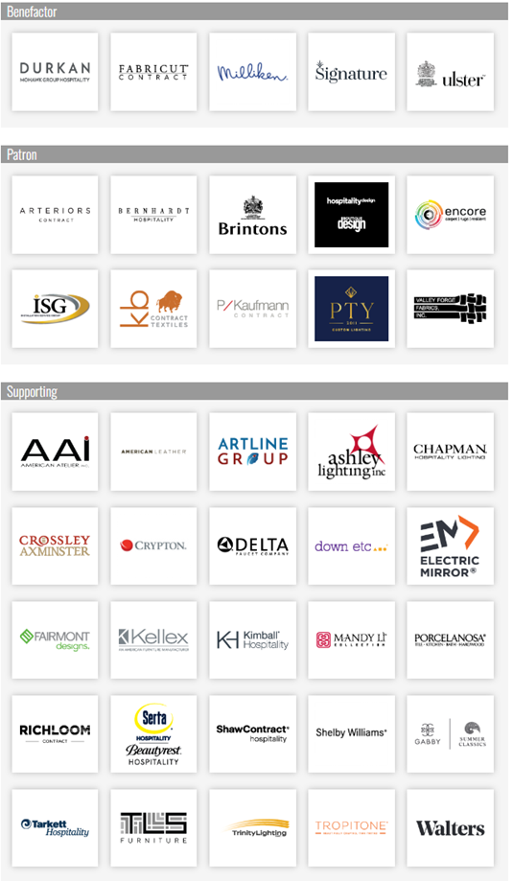
Corporate Partners
NEWH Corporate Partners are primarily comprised of manufacturers that manufacture products for the hospitality industry. These relationships bring financial stability to the organization.
Corporate Partners allow NEWH to keep dues at an affordable rate, host in-person International Board of Director meetings and support new membership initiatives.
NEWH has 3 levels of NEWH Corporate Partnership ($18,000-$38,500 USD per year).
Notes:
Emailed Trisha 9/6

Slide 13
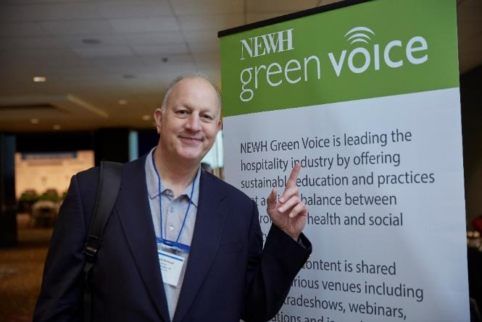
Green Voice
NEWH supports a focused educational initiative related to sustainability and the protection of our environment.
Green Voice Partners financially support the needs related to resourcing credible talent and professional expertise that can deliver comprehensive knowledge about sustainability at international expositions and conferences.
NEWH includes the vision of our students through design competitions tapping into their creative design solutions that benefit the world of hospitality.
Notes:
Emailed Trisha 9/6

Slide 14
Media
NEWH Media Partners bring strength to the extensive international network with their vast reach into the market connecting with executives and professionals that lead the industry with innovative thought, influence, and action.
These partners provide NEWH and its members presence at the international expositions, conferences, and trade fairs allowing NEWH the opportunity to spread their message and share initiatives that benefit the entire industry and those that support it. Many of these partners assist NEWH in promotion of its members and supporters through their globally renowned publications.
Notes:
Emailed Trisha 9/6

Slide 15
Brand
NEWH BrandED Program Partners lead the charge for bringing the highest level of education to our professional members. We provide live educational sessions that host the brand partners as they share pertinent information with a perspective on pipeline and design expectations related to the brand distinctions.
NEWH BrandED Program Sponsors are manufacturing companies that support this educational and networking initiative for NEWH. This program funds multiple scholarships per year presented at international events.
Notes:
Emailed Trisha 9/6

Slide 16
Design
NEWH is committed to acknowledging and promoting its member firms through programs such as Top Interior Designers (TopID), which celebrates its talented and innovative design professionals.
We are proud to promote our members throughout the world as leaders in design excellence with a heart for giving back to the hospitality community.
Notes:
Emailed Trisha 9/6

Slide 17
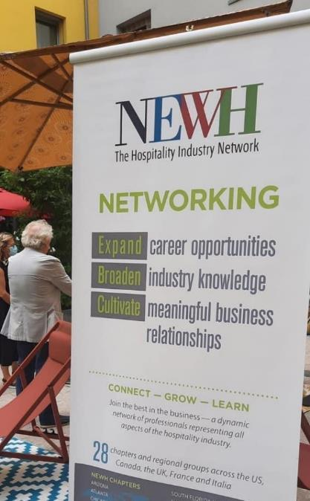
International
The strength of NEWH’s network comes from the expansion of Chapters and Regions to selective hospitality communities.
We align with International Partners that provide financial support and cultural guidance related to building these regions to support their businesses and local hospitality industry.
Notes:
Emailed Trisha 9/6

Slide 18
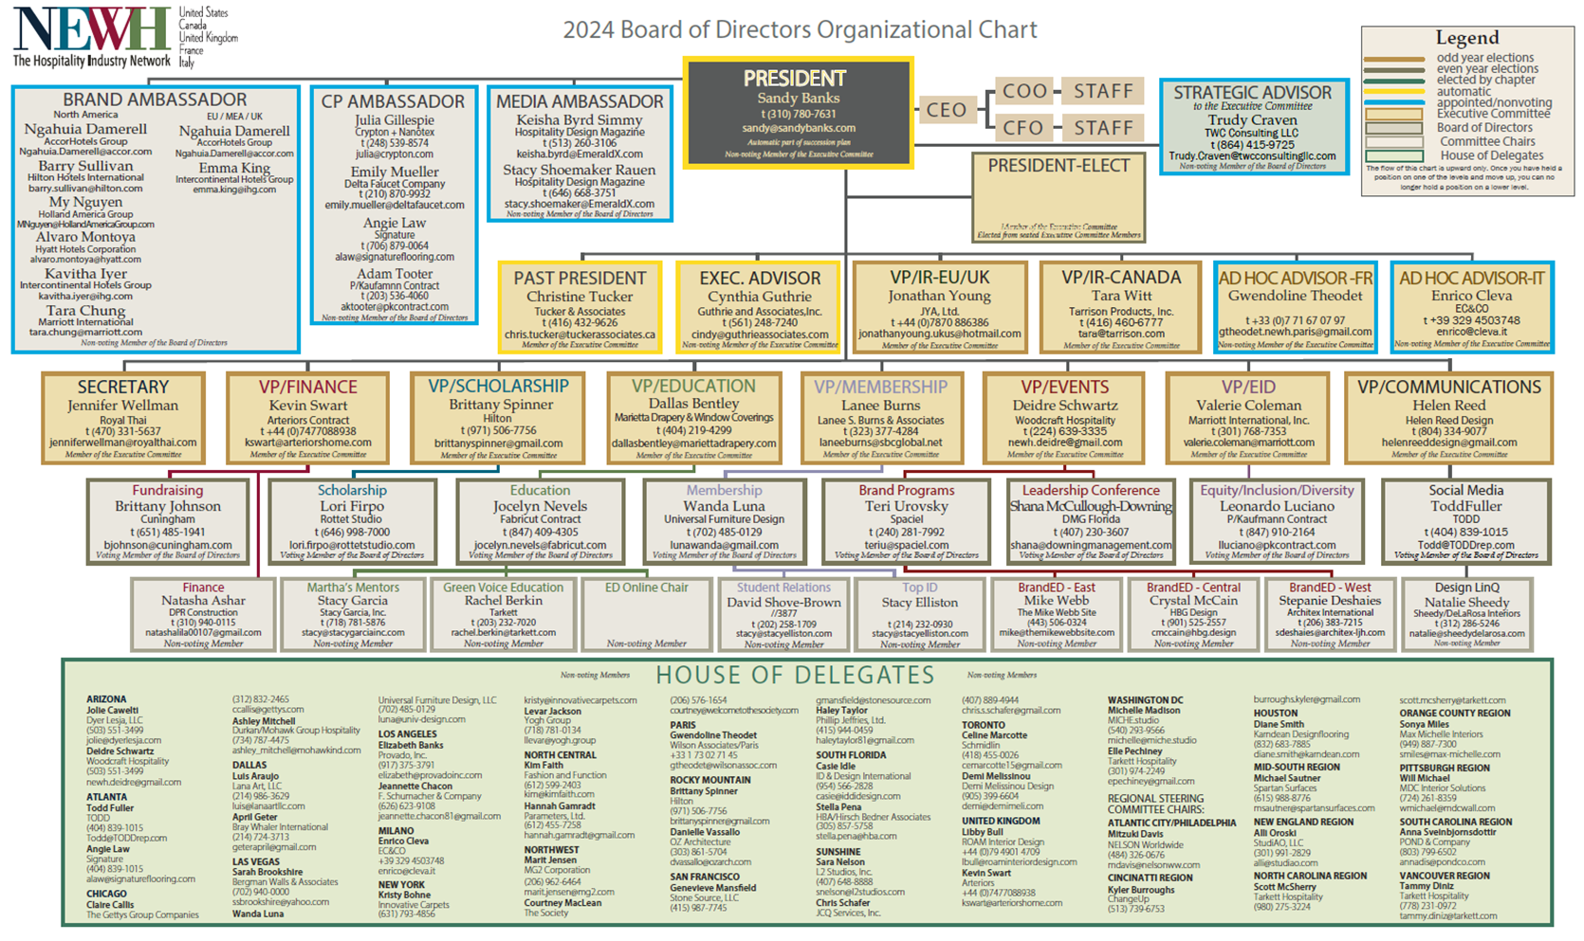

Slide 19
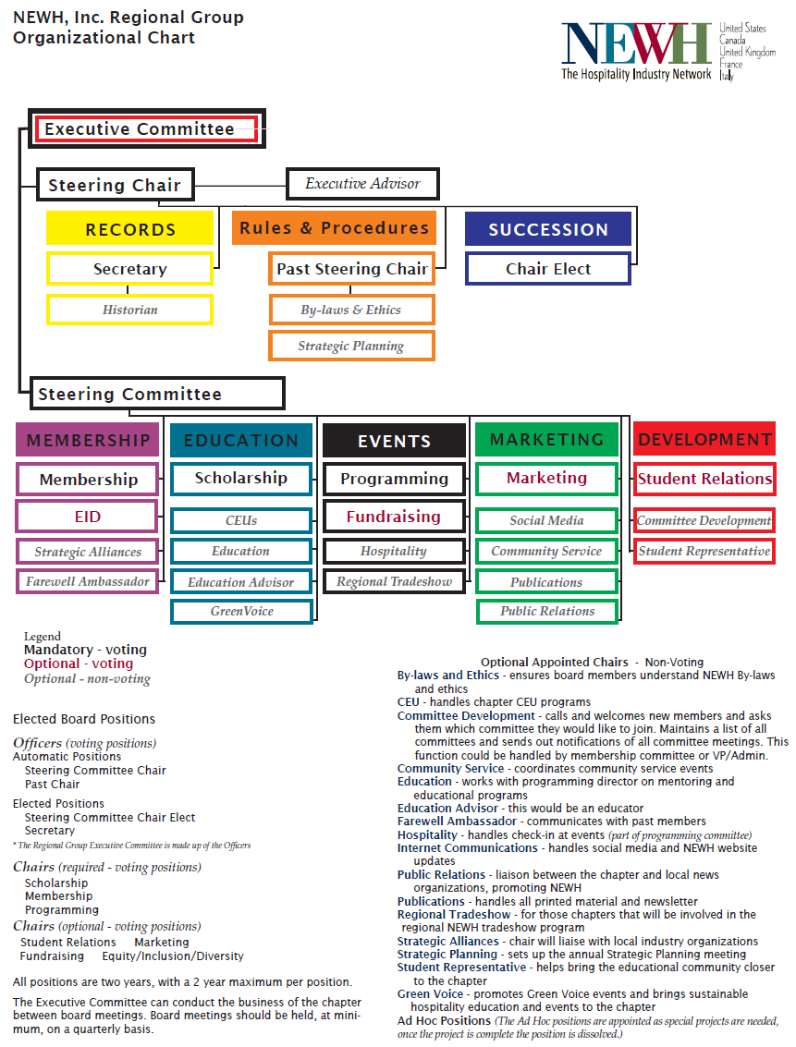

Slide 20
Steering Committee Positions
Executive Committee (1 vote each, unless indicated)
Steering Committee Chair* (no vote, unless tie)
Steering Chair-Elect
Secretary
Past Chairperson
Executive Advisor* (no vote)
* All positions are 2-year terms, Steering Chair-Elect is a one-year term and appointed by the committee mid-term
Steering Committee Chairs (required - voting positions)
Scholarship
Membership
Programming
Chairs (optional – voting)
Marketing
Student Relations
Fundraising
Equity/Inclusion/Diversity
Quorum = 50% of voting members+ 1
Email Vote: Can be done, but you must have 100% participation/reply and the vote must be unanimous

Slide 21
Steering Committee Positions continued
Optional Appointed Chairs (non-voting)
By-laws & Ethics – ensures all Steering Committee Members are familiar with the NEWH By-laws and Ethics
CEU – supports Programming Chair in researching available CEUs to offer at general meetings
Committee Development – ascertain members’ talents and interests and solicits them to serve on a committee
Community Service – coordinates community service events
Database – charged with updating the Region’s mailing/email list (given to them by NEWH, Inc.)
Education – works with Scholarship Chair on outreach to higher education schools who have hospitality programs
Education Advisor – this would be an educator
Farewell Ambassador – communicates with past members on reasons why they left the Region in hopes of improving member retention
Historian – Keep all written documents, Region news articles, literature, event invitations, photographs, etc. for historical documentation of your Region
Green Voice – promotes Green Voice events and brings sustainable hospitality education and events to the Region
Public Relations – liaison between the Region and local news organization
Publications – liaison between the Region and the local news organizations, promoting NEWH
Regional Tradeshow – works with NEWH, Inc. Tradeshow Director and Coordinator to plan regional tradeshow hosted by the Region
Social Media – handles social media and NEWH website updates
Sponsorship/Partner Engagement – ensure that sponsors receive promised sponsor benefits
Strategic Alliances - charged with working with other associations or like groups to develop programs or other offerings that would benefit NEWH and its members
Strategic Planning – works with NEWH, Inc. in offering annual strategic planning session and Steering Committee Training to the Region and helps develop the Region’s annual strategic plan
Student Representative – helps bring the educational community closer to the Region
Ad Hoc - approved as special projects are needed, once the project is complete the position is dissolved

Slide 22
What is an NEWH Regional Group?
A Regional Group is for those members who are in an area that does not have a large hospitality community, but still want to be affiliated with NEWH, Inc. and would like the opportunity to get together on a regular basis to network and form relationships.
Our Regional Group Model provides for members to gather under the authority of NEWH, give a scholarship each year, and work toward Chapter-hood, if feasible.
It is not only what you know, but who you know… under the known umbrella of the industry’s premier organization, NEWH .

Slide 23
What is the difference between a regional group and a chapter
Regional Group
Chapter
5–6-person Steering Committee – required to meet once a quarter
No checking account
Hold 3-4 programming/networking (no-host) events per year
If the Regional Group does not have the funds in its scholarship account, NEWH, Inc. will subsidize one $2,500 scholarship award annually
Full Board structure – required to meet monthly
Has 2 banks accounts – one administrative and one scholarship
Hold 4-6 programming/networking events per year
Responsible for holding at least one (1) fundraising event per year to raise funds for education and scholarship
Gives annual scholarship(s) – Chapter Board can determine how many and $ amount
Nonprofit registration is filed by NEWH, Inc. to keep Chapter in compliance with state regulations

Slide 24
Regional group goal
The MAIN goal is to provide a networking relationship building opportunities for members of the hospitality industry.
The NEWH Regional Group should get the word out about NEWH Let people know what NEWH is, what it stands for, benefits of becoming involved (networking, business development, giving back to the industry, etc.).
Programs should promote the goals of the NEWH and maintain the high standards that reflect the nature of the organization.
NEWH = Networking with a higher purpose (scholarships)

Slide 25
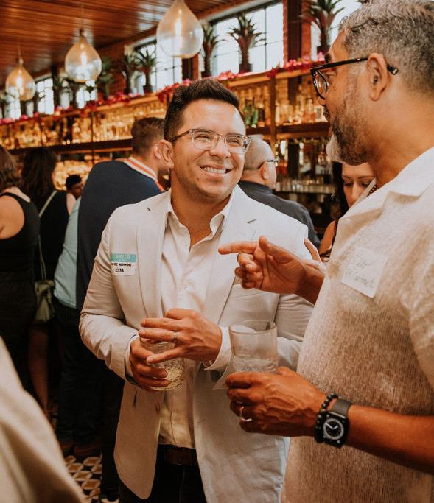
Regional Events
The group will be encouraged to hold “no-host” happy hour type events or no-host luncheons to develop interest in the Region.
“No-host” events are those events where there are no expenses to hold the event and no ticket prices to attend. Regional Groups do not hold a bank account, so the majority of events, if not all, should have no expenses involved.
Determine what type of event will best suit your area. Suggestions:
Happy hours
Luncheons
Hotel tours
Sponsored CEUs
Sponsored showroom events/tours

Slide 26
Steering Committee
This committee will form the nucleus of the organization. New people should be brought on to the Steering Committee each year to keep the ideas fresh and new and the Regional Group moving forward.
Ideally the committee would appoint a Chair-Elect a year before the Chair’s term is complete. The Chair-Elect would shadow the Chair for a year prior to assuming the Chair role.
The Steering Committee will meet at minimum, quarterly. Minutes of all meetings must be taken and submitted to the NEWH, Inc. Office.

Slide 27
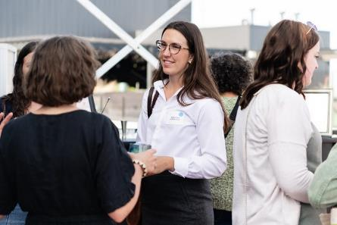
How can I be a valuable Steering Committee member?
Promote NEWH to others; understand the mission/history.
Understand roles and responsibilities; hold others accountable.
Live your role and responsibilities; hold yourself accountable.
Stay in your lane.
Cross over lanes when asked.
Come prepared (review agenda and supporting documents).
Treat information and discussions as “confidential”.
Be curious about different perspectives/practice teamwork.
Consensus means “I can live with it” and will support it as a team.

Slide 28
The Steering committee NEWH, Inc. Staff Relationship
Two Elements, One Team
Consider it a partnership, alliance, collaboration between Regional Groups and the NEWH, Inc. Staff to achieve the goals of NEWH.

Slide 29
Function and Support from NEWH, Inc.
The function of the NEWH, Inc. Office is to run the business of the organization and support its NEWH, Inc. Board of Directors, Chapters and Regional Groups.
Support for the Regional Groups will include:
Handle all dues collections and disbursement of funds
Support members’ online activities, Membership and Resource Directory, NEWH website, etc.
Maintain master Regional database (Keep mailing list current by forwarding any new or revised contact information to the NEWH, Inc. Office)
If needed, help setup/design event invitations
Broadcast event invitations
Handle online RSVP for all events
Setup and help maintain Regional Group web page

Slide 30
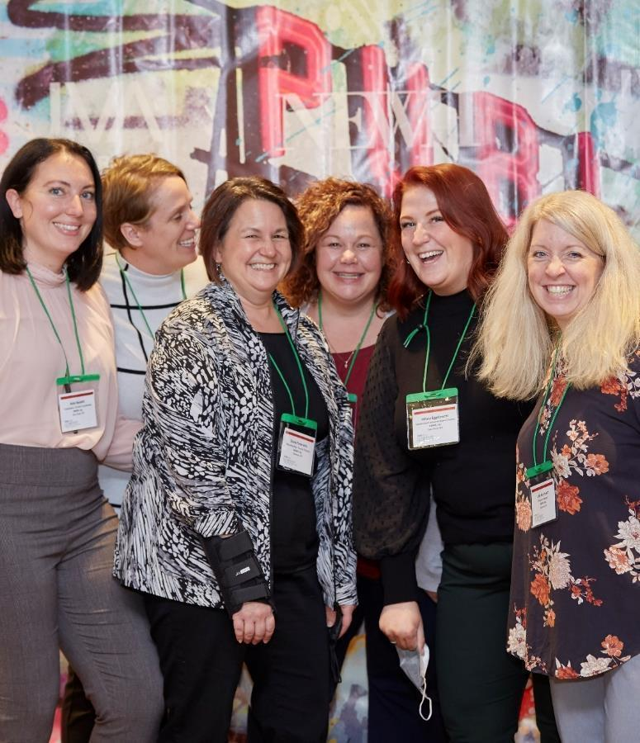
Contact Us!
Feel free to contact the NEWH, Inc. Office if you have ANY questions.
Questions can be directed to:
President/VPs/Delegates – Shelia Lohmiller or Diane Federwitz
Treasurer/Finance/Insurance – Susan Huntington or Julie Hartmann
Secretary – Sarah Von Deck
Office Administrator – Sarah Von Deck
Membership – Diane Federwitz or Kathy Coughlin
Scholarship/Education/EDOnline – Erika Swansen
Communication/Marketing/Social Media – Hillary Eggebrecht
Programming/Fundraising – Diane Federwitz; Event RSVPs – Julie Hartmann and Denise Huntington
Regional Tradeshows/Corporate Partners/Leadership Conference – Jena Seibel and Kate Nesbitt
Website/Newsletters – Diane Federwitz
Other questions – just call, we’d be glad to help!

Slide 31
Contact Us!
Email us directly at: General emails:
diane.federwitz@newh.org newh.membership@newh.org
jena.seibel@newh.org newh.education@newh.org
julie.hartmann@newh.org newh.finance@newh.org
kathy.coughlin@newh.org leadership.conference@newh.org
hillary.eggebrecht@newh.org newh.scholarship@newh.org
kate.nesbitt@newh.org newh.tradeshows@newh.org
susan.huntington@newh.org continuing.education@newh.org
shelia.lohmiller@newh.org newh.magazine@newh.org
erika.swansen@newh.org
denise.huntington@newh.org
sarah.vondeck@newh.org
NEWH, Inc.
P.O. Box 322
Shawano, WI 54166-0322
800.593.NEWH (6394)
Fax 800-693-NEWH (6394)
info@newh.org

Slide 32
Committee do’s & Don’ts
Do:
Choose members carefully, include non-Steering Committee Members for committee service (If you need help recruiting, conduct a member talent survey – contact the NEWH, Inc. Office for info).
Distribute committee assignments evenly across the Steering Committee so all members are involved.
Give goals and provide follow-up communication/connect with Committee Members on an ongoing basis to ensure success.
Get approval from the full Steering Committee before making important decisions.
Write committee reports providing info to Steering Committee.
Don’t:
Create committees that are too large to be effective.
Treat non-Steering Committee Members as outsiders.

Slide 33
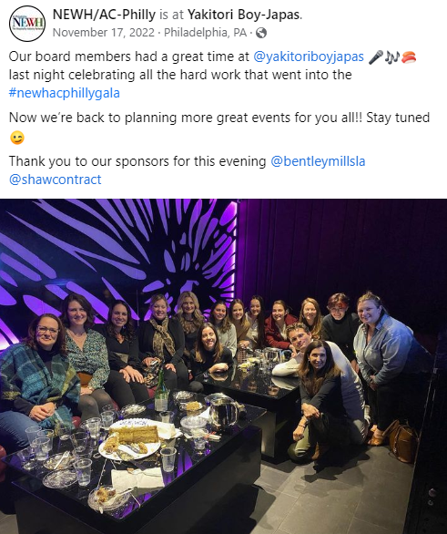
Post your steering committee hard at work…

Slide 34
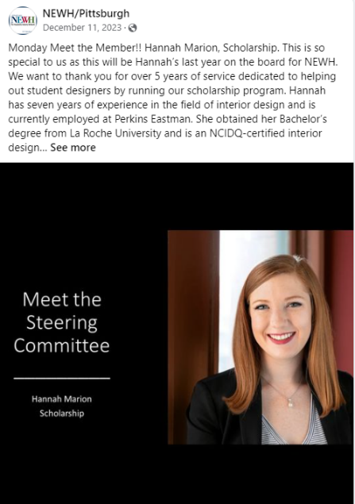
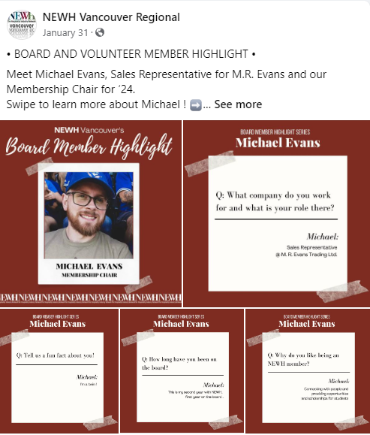
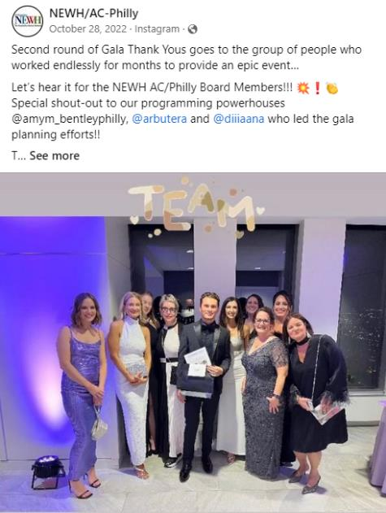
HIGHLIGHT YOUR steering committee AND THANK THEM!

Slide 35
Role of the Steering committee chair
The Chairperson shall have general supervision and control over the Regional Steering Committee’s affairs. The Chairperson shall:
Create meeting agenda and distribute in advance of meeting; solicit agenda items from Steering Committee Members
Encourage discussion and input from all Steering Committee Members
Supervise and direct the business of the Region, keeping all Steering Committee Members focused on setting and meeting the goals of NEWH
Encourage future leaders
Encourage teamwork and ensure involvement of all members in the Region

Slide 36
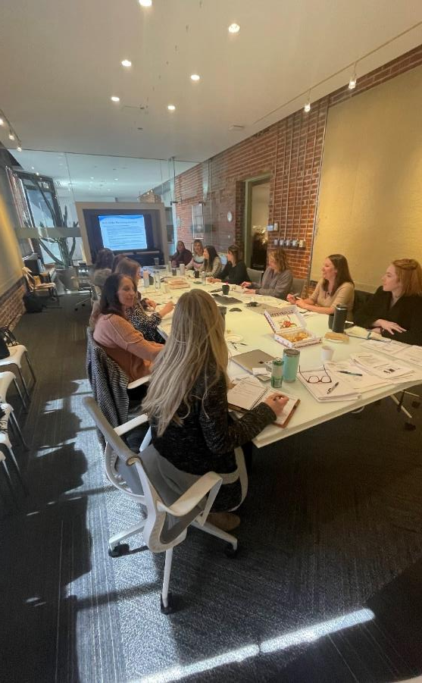
Role of the Steering Committee Chair continued
They shall act as liaison between the Region and NEWH, Inc. Board.
The Steering Committee Chair must attend a minimum of two (2) NEWH, Inc. Board meetings a year – these Board meetings are held 3 times a year (Jan/Feb [required], May/June, and November). Attendance is in-person or Zoom.
Responsible for providing a written report to the NEWH, Inc. Office prior to the NEWH, Inc. Board meeting.
Provide a written report of the NEWH, Inc. Board meetings to their Region the month following a NEWH, Inc. Board meeting.
Submit travel reimbursements within 60 days or there will be no reimbursement.

Slide 37
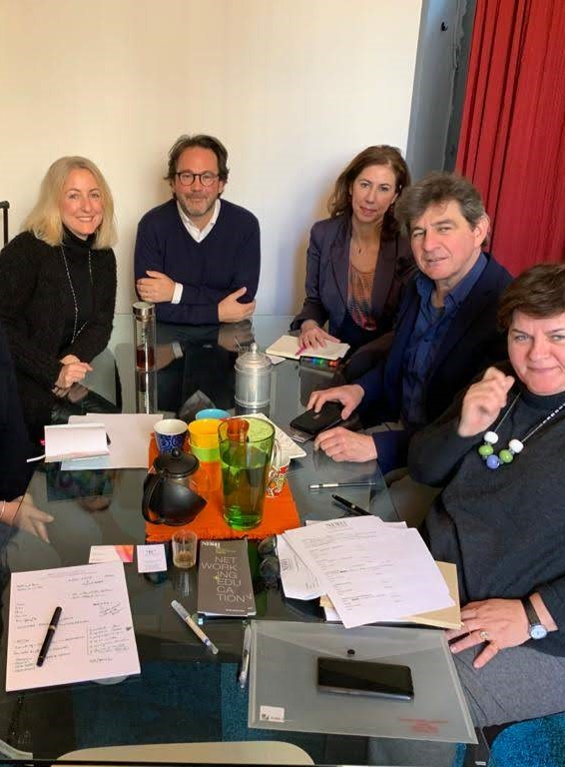
NEWH Reimbursement policy For Steering Committee Chair
NEWH, Inc. has a very conservative travel reimbursement policy.
NEWH, Inc. will cover ½ of the NEWH, Inc. Board Members and Steering Committee Chair’s airfare and ½ of their room expense for two (2) nights max to attend regularly scheduled Board of Directors meetings (if these expenses are not being covered by their business). The Region covers the other half of airfare/lodging and includes it in annual budget. Room rates are based on double occupancy with qualified Board Members.
Please note: There are caps on airfare and lodging based on location – Steering Committee Chairs are informed of the caps in the meeting announcement sent by NEWH. NEWH will reimburse up to $50 of additional approved expenses with receipt. An approved expense is transportation or meals (no alcohol). Submit to newh.finance@newh.org.
If, in your normal course of business, you will be attending (or exhibiting at) an event, you should only request the appropriate portion of one-night’s lodging and no airfare.
NEWH, Inc. will not reimburse NEWH, Inc. Board Members/Delegates/Steering Committee Chair travel expenses if they have not turned in their discipline/Chapter/Region Board Report.

Slide 38
Steering committee chair Role in Successful/Productive Meetings*
Start and stop on time (timekeeper is Past Steering Committee Chairperson)
Require cell phones off, or silenced and put away
Request one conversation at a time; no sidebar conversations
Follow Robert’s Rules of Order and NEWH By-laws to maintain order at meetings
Require meeting attendees to raise hand and be recognized before speaking
Set time limits on topics
Create a ‘Parking Lot’ for any discussions that need to be tabled or that get off track of meeting agenda/committee work
Don’t get involved in personalities, keep the discussion on issues
Majority vote is the way to make decisions
*Regions are required to have quarterly meetings
Notes:
tweak

Slide 39
Role of the Past Steering Committee Chairperson
The Past Chairperson supports the Steering Committee and serves as parliamentarian at Regional Steering Committee meetings and chairs the nominations committee. The Past Chairperson shall:
Be a brain trust to the committee
Have a clear understanding of parliamentary procedure
Serve as timekeeper of Steering Committee meetings
Take minutes in absence of Secretary
Chair the nominations committee, helping to identify potential Steering Committee candidates, contacting members who have been nominated for acceptance of nomination
Encourage future leaders
Encourage teamwork and ensure involvement of all members in the Region

Slide 40
Role of the steering Committee Executive advisor
The Executive Advisor can be filled by the past chair OR can be an outside industry notable who is interested in helping the committee. The Executive Advisor shall:
Support the Steering Committee and serve as a mentor
Be available to the Steering Committee as a sounding board for any type of questions or issues they may have
Encourage future leaders

Slide 41
Role of the steering committee chair-elect
The Chairperson-Elect will:
Shadow the Steering Committee Chair
Join a committee
Assume the position of Committee Chair at the end of the current Chair’s term

Slide 42
Role of the secretary
Keep minutes of all meetings and actions of Steering Committee Members.
Take roll call and ensure a quorum is established (50% of voting members plus 1)
Minutes are a legal record of the Steering Committee meeting
Minutes are not a record of side conversations or reminders
If a meeting is not scheduled for the next month, the minutes should be voted/approved via email
Properly store all meeting minutes and Regional Group documents (event mailers, program notices, letters, etc.) in order to ensure historical documentation and legal compliance

Slide 43
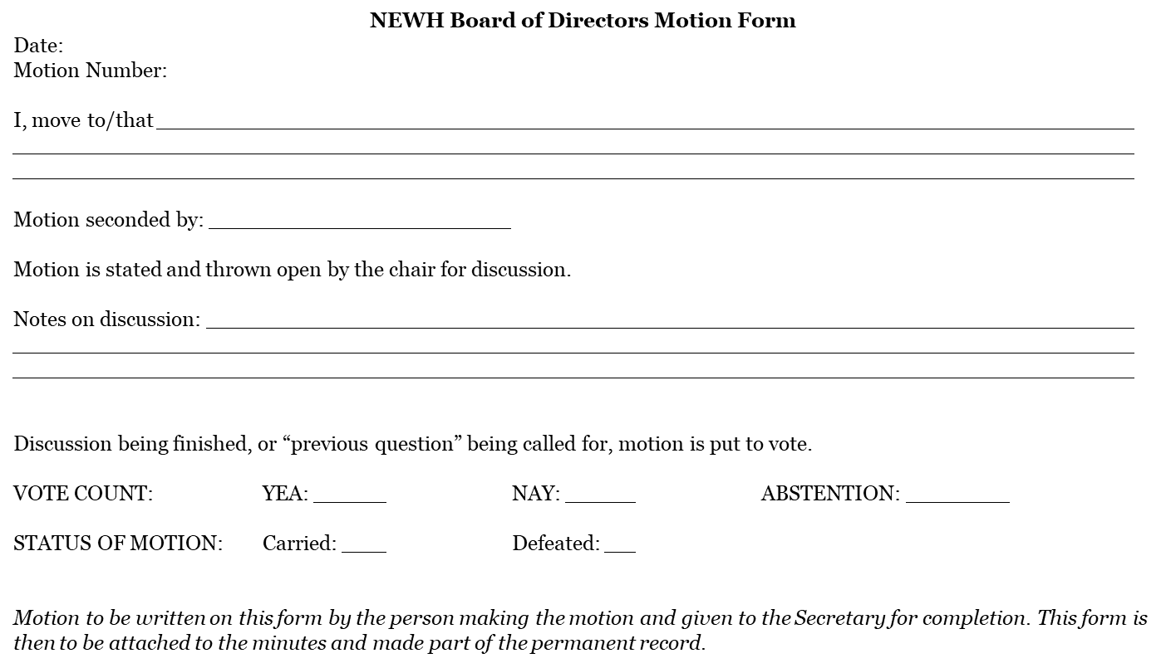
MOTION FORM TEMPLATE

Slide 44
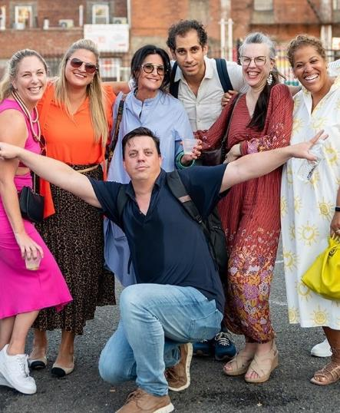
Role of membership Chair
Actively recruit new members for the Region
With Programming Chair, coordinate and implement a “Membership Drive” as part of a Regional Group
Ensure NEWH information (brochures, applications, etc.) is available at events for potential members.
Encourage prospective new members by calling/emailing them to answer any questions and encourage them to Join Online.
Call/email new members within 5 business days of approval welcoming them to your Regional Group and informing them of future Region events.
Forward all original approved applications and payments to NEWH, Inc. within 30 days of application – review online applications with Steering Committee and submit approvals to NEWH, Inc. within 30 days of application – NEWH, Inc. will mail new member packets.
Introduce or recognize all new members at Regional events.
Throughout the year, chair the membership renewal committee, calling all members who have not renewed as well as those whose membership is due in the upcoming month.
Maintain existing members – with committee members, call/email current and recently lapsed members urging them to renew their dues.
Keep Regional Group mailing list current by forwarding any new or revised contact information to the NEWH, Inc. Office to update your master list.

Slide 45
Membership impacts scholarship
One-half of your Regional membership dues will directly impact a student…
That is a POWERFUL statement to share will all potential members.

Slide 46
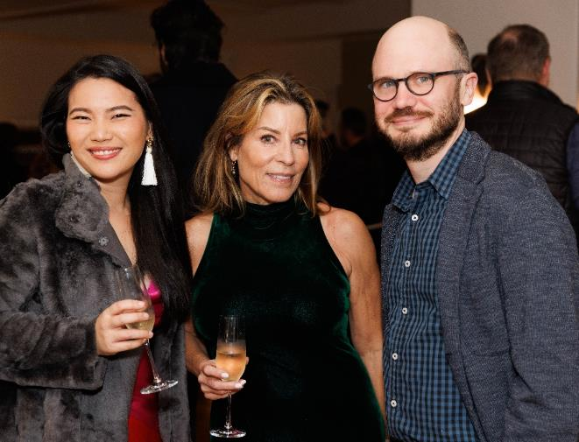
Membership levels
General Member – open to professionals who have been actively involved in Hospitality or a related field for one or more years.
Associate Member – open to those industry members who have, within a 12-month period, completed an accredited area of hospitality related studies. The associate membership category will be available to these members for three (3) years. Associate member cannot hold an elected office but are encouraged to serve on Regional Group Committees. ($50 membership)
Education Professional Member – those who are full time educators of Hospitality –Related Studies. (Free membership)
Student Member – those who are enrolled in an accredited place of secondary education, majoring in Hospitality related studies. Student members will receive one year of free Associate membership upon graduation in order to facilitate the transition to General membership. (Free membership)
Retiree – those who are retired and 65 years or older. (Half-off dues)

Slide 47
Business membership levels
Business PLUS – $7,500
The Business PLUS membership belongs to the business and includes 20 members (national/international), and up to 10 additional discounted memberships. Additionally, this membership category includes:
One (1) guaranteed regional tradeshow placement over a two-year period (not including the actual tradeshow fee)
A one-quarter page ad in NEWH Magazine
Unlimited courtesy listings in the NEWH Career Network
Company listing in the Member Directory and Member Directory, and premium listing in the Resource Directory (includes logo and 4 product/installation images)

Slide 48
Business Membership Levels continued
Chapter Level Business (CLB) Member – $425 ($500 CAD, £300)
This is the perfect membership for those businesses that have more than one employee at the same geographic location who are interested in joining the local chapter.
Membership belongs to the business and includes 2 courtesy memberships and up to 4 additional discount memberships ($75 US; $91 CAD; £60 UK)
All employees of CLB can attend primary chapter programming events at member ticket cost (excludes fundraising events)
Marketing benefits – premium listing in Resource Directory (includes logo and 4 product/installation images) and listed in Business Member Directory
CLB Member – TOP TIER $1,000 ($1200 CAD, £700)
Top Tier membership enjoys the same benefits as the Chapter Level Business but includes 6 courtesy and up to 6 discount memberships

Slide 49
Corporate Partners
Corporate Partner Courtesy and Discount Member
Each Corporate Partner level includes a number of courtesy memberships (chosen by the corporate partner) as well as a number of discount memberships. Corporate Partner memberships are not voted on but rather approved due to their approved partnership.
NEWH has 3 levels of NEWH Corporate Partnership ($18,000-$38,500 per year). Within each level the company receives a certain amount of courtesy as well as discounted memberships to allocate as the main contact chooses. This is not per Chapter.
Supporting Level - 25 partners
Receives 5 courtesy memberships and up to 5 more at a discounted rate.
Patron - 10 partners
Receives 10 courtesy memberships and up to 10 more at a discounted rate
Benefactor - 5 partners
Receives 20 courtesy memberships and up to 20 more at a discounted rate
Any questions from a potential member on receiving either a courtesy or discounted membership from their company should be emailed to jena.seibel@newh.org. Jena will contact the main decision maker for the partnership to find out what is available.

Slide 50
Ways to show member value
Events
offer member tickets at a lower cost or free
offer event tickets to members first for highly coveted programs, or those events with limited capacity
offer event sponsorships to members first or offer sponsorship discount to members
offer members the opportunity to be a panelist, provide a tour of a new or renovated space, or host a showroom event or educational event (CEU)
hold a members-only drawing at your events
Marketing
post member news on chapter social media sites, NEWH Magazine, chapter website, and chapter publications (new positions, new products – provide link to company website)
create a member spotlight on your chapter page, highlighting a member each month
recognize your chapter’s Top ID recipients on social media and publications
identify members at your event with a member ribbon or sticker – make them feel special!
Networking/Leadership Opportunities
access to NEWH member directory to facilitate introductions and one-on-one networking
ability to serve on your chapter board in a leadership position
access to top level emerging talent through schools, scholarship recipients, and education professionals

Slide 51
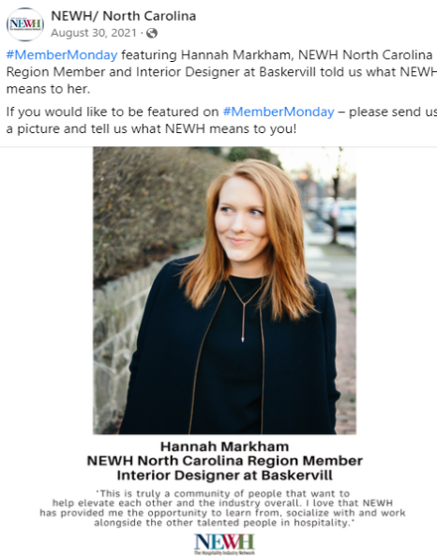
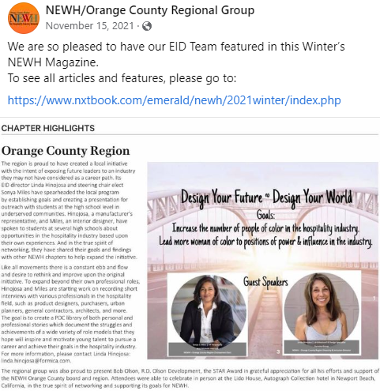
Take every opportunity to promote your members…member news in the NEWH Magazine, member spotlights on your website, or post news on facebook

Slide 52
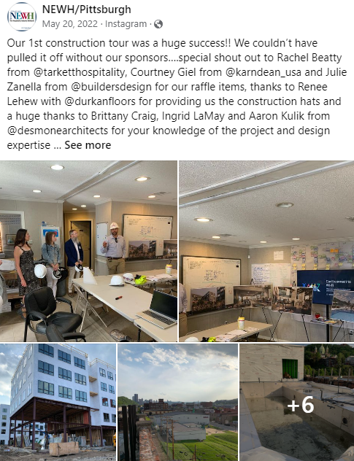
Highlight your local design firms on social media… Idea: Firm Friday!

Slide 53
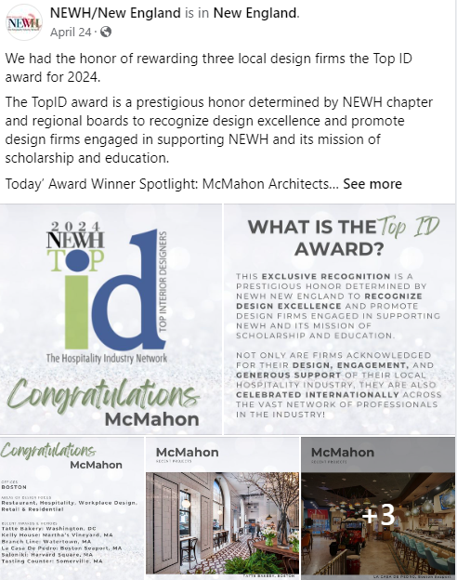
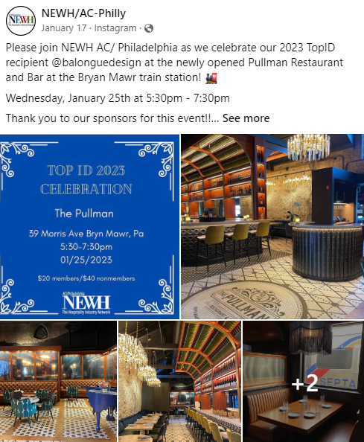
More ideas to promote members – highlight your TopIDs on social media!

Slide 54
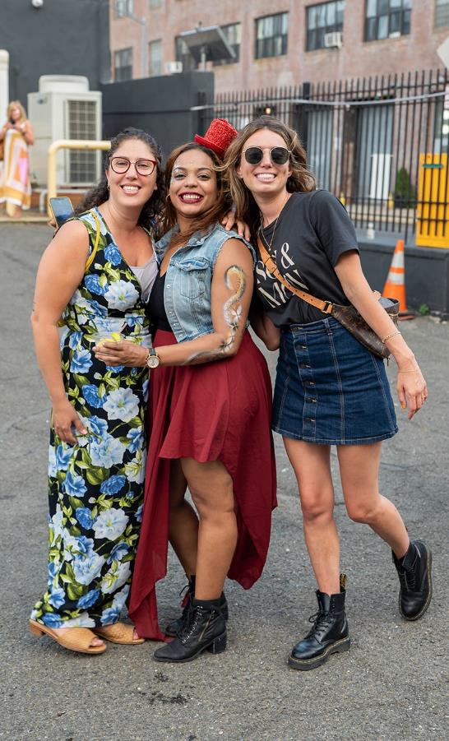
What is the difference between a program and fundraising event?
What type of event did you hold?
Was it FUN – was it a FUN party? NEWH doesn’t throw parties unless they are FUNdraisers.
Did you have a speaker, a panel discussion, a tour, did industry members find your event informative and educational? You just held a Program.
A FUNdraiser’s purpose is to raise money for Scholarship and Education– the event proceeds must be a minimum of 40%. A program’s purpose is to network and build membership and should cover its costs and may have minimal proceeds of 5 – 10%.
Happy Hour events are neither a program or a FUNdraiser, they are not required to have any proceeds, no speakers or tours are necessary. You have not contracted with a venue to provide a special room, etc. for a Happy Hour type event.
Note on Raffles/Auctions – total dollars taken in for a raffle/auction is not included into your total income for a programming event - these are fundraising dollars and need to be reported to NEWH, Inc.
Be sure to know your state/county guidelines regarding raffles (contact Susan Huntington in the NEWH, Inc. Office to help with that).
Notes:
Should this slide be moved to be under the Fundraising/Programing Director?

Slide 55
Role of Programming Chair
The Programming Chair will:
Plan and implement each networking event.
Review with the Steering Committee a list of possible events for the year. Consider:
Location: are members/potential members spread out in your geographic area? If so, plan events in areas to attract A&D people. Look for convenient locations with easy parking/access to public transportation
Time of day: lunch hour vs. after business hours
Type of event:
No-host* happy hours of exciting new spaces (“No-host” events are those events where there are no expenses to hold the event and no ticket prices to attend.)
Luncheons (only if it works in your area)
Hotel tours (designers LOVE these)
Sponsored CEUs/showroom events (works best if combined with another event and if accreditation needed)
A draft program schedule for the year should be shared with NEWH, Inc. to post on the NEWH website – keep NEWH, Inc. informed of event specifics

Slide 56
Regional events
NEWH, Inc. Office Support
The NEWH, Inc. Office will send a broadcast email to your Regional list. We can accept RSVPs for you and provide you a link via Google Docs to monitor registration.
The NEWH, Inc. Office will be available to help create invitations and email to a targeted list of industry individuals in the area.

Slide 57
Regional Group Finances
NEWH Regional Groups are not allowed to have an admin/checking accounts. Because they are not a chartered entity within NEWH, Inc., they will not be registered in the state/province where they function.
The group will work with the NEWH, Inc. Office on event notice, deposits, online RSVP and payments, sponsorships, etc. Any excess funds raised by the event will go into the group’s escrow account.
If the Regional Group is planning an event with any type of expenses involved, try to cover those expenses with sponsorship dollars.
If the group has a negative cash flow at an event, they will not be allowed to hold another funded event for 6 months. (If two events lose money, NEWH, Inc. would no longer cover the Regional Group expenses.)
Payment by sponsors for event expenses should be directly to the venue/service provider or sent directly to NEWH, Inc.
Please contact the NEWH, Inc. Office with any questions/ clarifications regarding Regional Group events.

Slide 58
Funded/Ticketed events
Established Regional Groups typically hold an average of three to five funded events per year
One event should include a presentation of the annual Scholarship and TopID.
A budget for the event must be submitted to the NEWH, Inc. Office for approval prior to moving forward with any events
To prepare a budget for the event:
Get bids for venues, food, drinks, entertainment
Establish admission fees, sponsorship levels and amounts
Use the event budget template (template can be found online in NEWH, Inc. Board Resources, Regional Groups area)
Secure NEWH, Inc. approval for event budget
Keep accurate record of all income and expenses

Slide 59
Funded/ticketed Events continued
If needed, ensure sponsors are acquired to underwrite your event
Promote and develop relationships with vendors and other possible sponsors
Look to different avenues as a source of a potential sponsor to include hotels, A&D vendors, restaurant operations and other firms associated with the hospitality design community
Develop new sponsor contacts - trade magazines, members and previous sponsors are a good source to develop potential and maintain sponsors
Payment for event tickets must be by:
Online payment using NEWH online RSVP system
Payment at the door using Go Payment app
Cash at the door
Check at the door
Any monies collected at the door should be sent to the NEWH, Inc. Office for deposit/processing

Slide 60
Event Invitation
Save the Date – Email approved save the date to Diane at the NEWH, Inc. Office for email broadcasting to your Regional list
Give NEWH, Inc. Office 2-3 days lead time for all broadcast requests
Broadcast the ‘save the date’ 4-6 weeks prior to the event
General info for a save the date would include type of event, date/time, and location if known
Invitation – Email approved invitation to Diane with all event specifics 3-4 weeks prior to the event with necessary RSVP information
Be sure all pertinent information is included on the invitation (date, time, location, ticket cost, fair market value, event sponsors)
If applicable, request NEWH, Inc. Office to set up online RSVP/payment
Fair market value statement should be on all meeting notices that has a ticket price – it can be small and unobtrusive – but it needs to be there.
“The Fair Market Value of this event is $xx.xx and may be tax-deductible as a business expense. The remainder can be considered a charitable contribution.”

Slide 61
Event Invitation continued
Be sure to have a difference in ticket price being a member vs. nonmember – make it apparent that NEWH Membership has value
Encourage people to RSVP early – think about early bird specials, open event to members only first, first 30 come for discounted rate, etc.
If RSVPs are online, Julie Hartmann checks membership against ticket purchased, ensures payment went through – contacts individual directly if any questions or issues, sends attendee list prior to event
Be sure NEWH Inc. Office is aware of any promotions for the event (ticket sales, sponsor tickets, etc.) which must be pre-approved by the NEWH, Inc. Office
Email broadcasts – encourage only 2 per event – get a Save the Date out early!

Slide 62
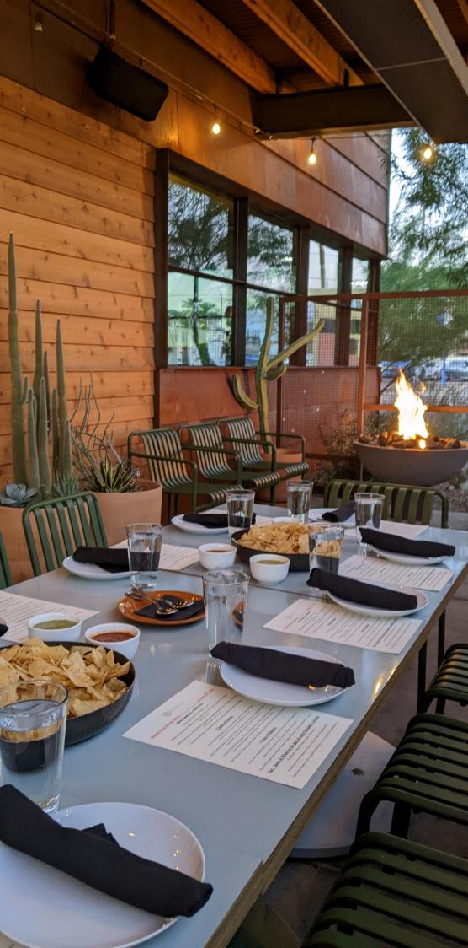
NEWH Event Refund/Cancellation Policy
‘See Terms & Conditions’ is in the footer of all checkout forms and states: Event Cancellation by NEWH.
NEWH and its Regions reserve the right to cancel an event due to low enrollment or other circumstances which would make the event non-viable.
If NEWH or its Regions cancel an event, registrants will be offered a full refund.
Should circumstances arise that result in the postponement of an event, registrants will have the option to either receive a full refund or transfer registration to the same event at the new, future date.
Registration Cancellation by Sponsor
Unless specifically stated on sponsorship materials, the policy to receive a refund for your sponsorship is:
30 days prior to the event – no refund
within 45 days of event 50% refund
within 60 days 75% refund
within 120 days full refund

Slide 63
NEWH Event Refund/Cancellation Policy continued
Registration Cancellation by Participant
Unless specifically stated on registration materials, the deadline to receive a refund for your event registration is:
Programming events: 10 days before the event for full refund
Fundraising events: No refund/non-refundable tickets
Cancellations received after the stated deadline will not be eligible for a refund.
Refunds will not be available for registrants who choose not to attend an event.
Cancellations will be accepted via phone, fax or e-mail, and must be received by the stated cancellation deadline.
All refund requests must be made by the attendee or credit card holder.
Refund requests must include the name of the attendee and/or transaction number.
Refunds will be credited back to the original credit card used for payment less any applicable credit card fees.
These above policies apply to all NEWH and Region Events unless otherwise noted in the corresponding event materials. Please read all individual event information thoroughly.

Slide 64
Insurance Coverages
Errors and Omissions - covers the actions of the leadership, for example antitrust violations, etc. – this is provided to each Region by the NEWH, Inc. Office.
Certificate of Insurance (COI) – covers event liability – this is the responsibility of your Region per event. Confirm with your venue if a COI is required to be on file for the event. Each certificate of insurance is $50. Contact Susan Huntington in the NEWH, Inc. Office 3 weeks prior to event to obtain a certificate.
Regions are required to purchase a certificate of insurance on an individual basis through NEWH for any NEWH sponsored event (it is not required for your monthly social events – i.e., Toasty Tuesdays, Thirsty Thursdays, Happy hours, etc. that take place in a bar/restaurant).
Notes:
Jena

Slide 65
NEWH Liquor Policy
The purpose of this general policy is to establish appropriate guidelines to protect Regions and NEWH from potential legal action associated with alcohol consumption at NEWH sponsored events.
If at any level NEWH serves alcohol, or sponsors, co-sponsors or participates in an event where alcohol is served, NEWH may be at risk of liability for claims arising from the conduct of persons who are intoxicated by alcohol served at the event.
Event venues must carry insurance and the Region should obtain a copy of insurance from the event venue prior to the event.
The certificate of insurance is only liability insurance, not host liquor liability which is a completely different policy.

Slide 66
NEWh Liquor Policy Guidelines
Do not allow continued service of alcoholic beverages to intoxicated individuals.
Obtain the appropriate certificate of insurance and copy of host liquor liability insurance for all applicable events.
Avoid “Open Bar”.
Engage licensed professional servers who are trained in responsible alcohol service, either as a third party or through the hotel or event facility where your event is located. Only the professional/licensed servers should provide, serve and sell the liquor being consumed. NEWH Members/Nonmembers or anyone representing NEWH should not be serving alcohol at an event.
Verify and comply with any State or local laws requiring licensing, training or certification for servers of alcoholic beverages.
Request that your server or event venue provide a copy of their host liquor liability insurance, and request that NEWH be named as an additional insured party.

Slide 67
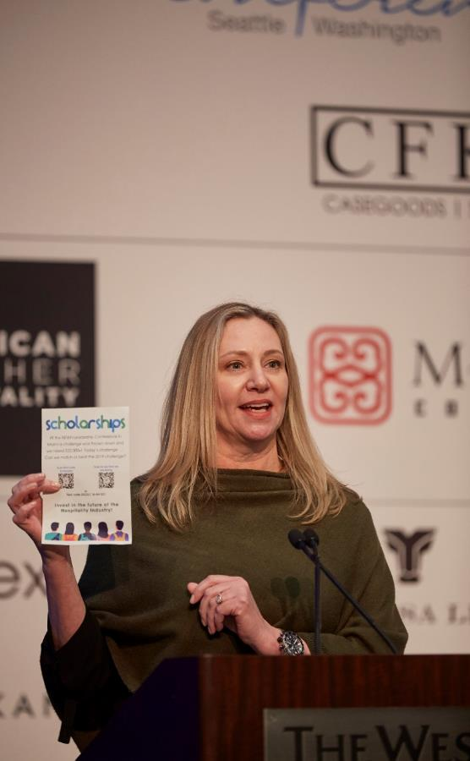
Role of scholarship Chair
The Scholarship Chair is responsible for reviewing and updating the school list sent by NEWH, Inc. annually. Updates are imperative to establish new contacts and update existing details.
NEWH, Inc. Office distributes to your school list by mail and email: scholarship application, letter, flyer and Facts brochure. Student members receive scholarship notice by email.
Applications will be sent to the Scholarship Chair; a committee can be formed to review and select the winner(s).
Within 30-days of application deadline:
Notify winners and non-winners (template letters available)
Submit winning applications & signed scholarship check form to NEWH, Inc.
NEWH, Inc. will create scholarship certificates for your awards event and process scholarship checks (checks can only be mailed + payable to college)

Slide 68
Regional Group Scholarship Guidelines
After being established as a Regional Group for a twelve (12) month period, the group will have the opportunity to present one (1) $2,500.00 scholarship per year. If the Regional Group does not have the funds in its scholarship account, NEWH, Inc. will subsidize the award.
If the group has additional funds in their scholarship account from member dues or other activities, they are free to use up to 50% of those funds.
The Regional Group shall have 15 voting members for no less than 12 months prior to funding the annual scholarship. The “funding date” would be the annual “group establishment date” anniversary as described in the handbook.
Fifty percent (50%) of the Regional Group members’ dues will be placed in a scholarship account to help cover the cost of the award.
All scholarships given must follow the established guidelines/criteria set forth by NEWH.

Slide 69
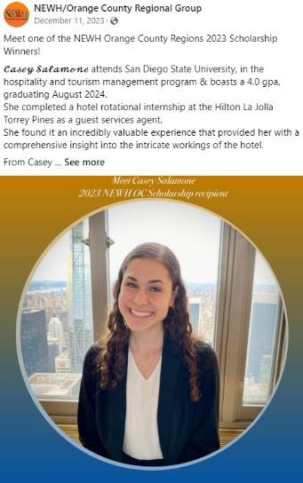
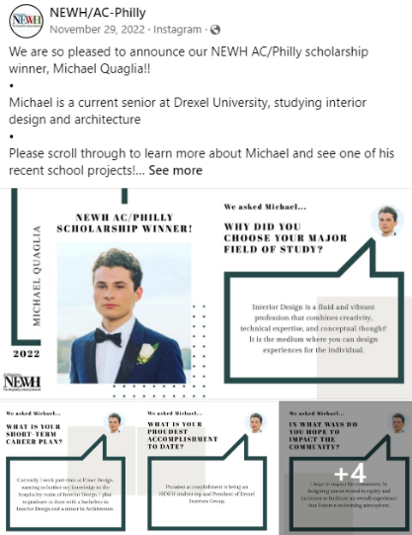
Congratulate and highlight your scholarship recipients on social media!

Slide 70
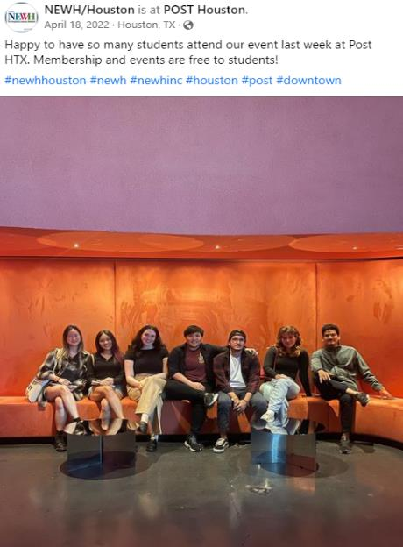
Share on social media how you are reaching out to students!

Slide 71
The role of the marketing Chair (optional)
Form a committee!
Use social media to promote the Region, its events, and its members on the Region’s Facebook, LinkedIn, and Instagram accounts (NEWH, Inc. has one main Twitter account that is linked to Facebook, Chapters/Regions do not have their own Twitter accounts)
Introduce new members
Promote your members’ new products/projects
Market your approved calendar of events – ensure information is posted on social media sites, shared with potential sponsors, and submitted to NEWH, Inc. Office to Diane Federwitz (diane.federwitz@newh.org) for inclusion on website
Send out your event calendar for the year (save the dates) in January
If possible, request and reserve sponsorships early in the year
Develop an annual marketing calendar to manage marketing communication, identifying deadlines for messages to be developed and released

Slide 72
Marketing Chair continued
Work with NEWH on an ongoing basis to update your Region’s website pages to ensure clear and current messages and information is posted including:
Member spotlight
Upload event pictures to Facebook AND Flickr – write event recap for your Region’s pages
Update your Region’s home page with recent news so it stays fresh
Ensure all marketing initiatives are developed and designed to reflect NEWH overall mission and the message is unified and consistent with the goals and objectives of NEWH.
Ensure that NEWH logo/brand guidelines are met on all marketing collateral distributed
Ensure Regional information is appropriately submitted in a timely manner for the NEWH Magazine (newh.magazine@newh.org)
Watch for deadline dates for member news!
Be sure any pictures sent in for magazine include captions (people’s names) or they will not be included

Slide 73
Be creative in promoting your events – build up excitement!

Slide 74
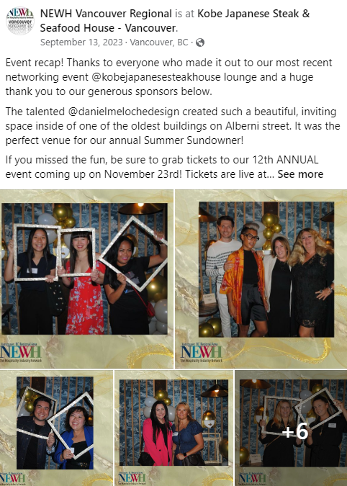
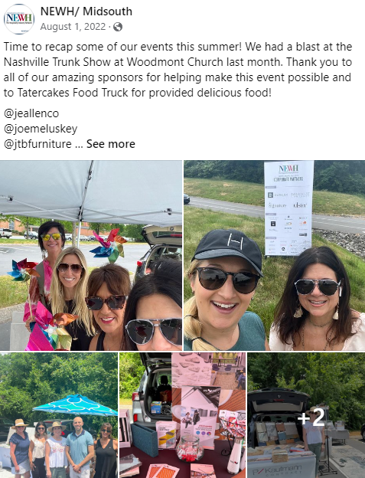
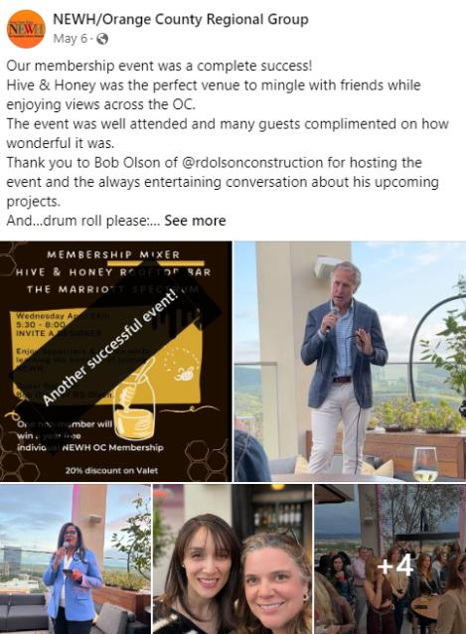
People LOVE to see pictures from your events!

Slide 75
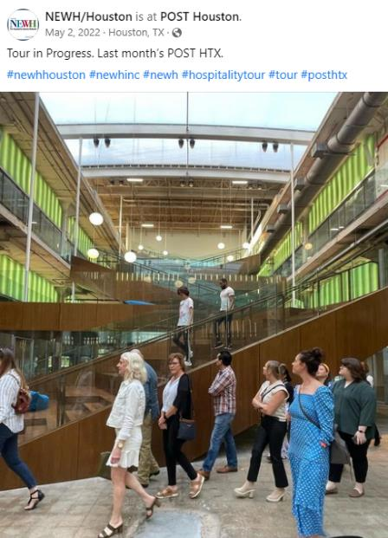
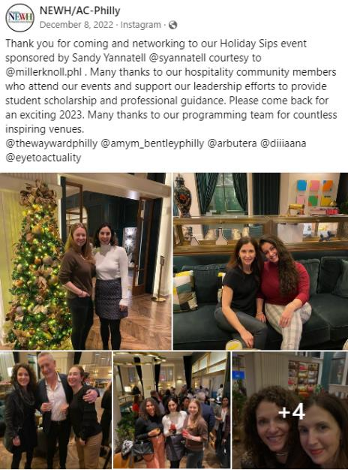
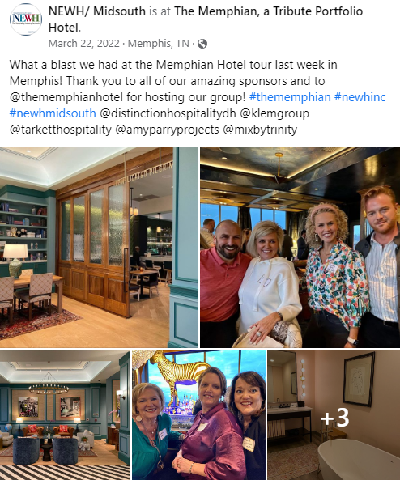
Post lots of pictures…show people what they missed!

Slide 76
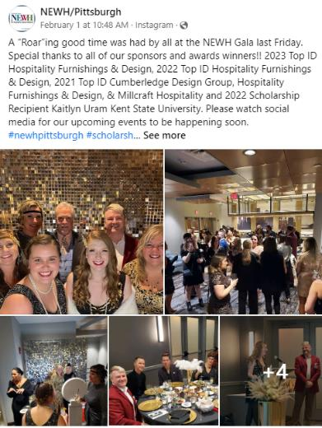
Thank your sponsors
Send a Thank You Letter
Thank sponsors on social media BEFORE the event
And…AFTER the event
Include:
The NEWH, Inc. Tax ID Number.
Any goods and services the sponsor received for their donation, along with the FAIR MARKET VALUE of the goods and services received (template available on the NEWH website).

Slide 77
Use Instagram to Raise Awareness of NEWH!
Post pictures of members
Post quotes that relate to our mission statement
Tell a short story
Hold contests
Thank event sponsors (include sponsor logo)
Post meeting notices on Instagram
Post event wrap-up photos (i.e., ‘look what you missed’)
Promote one member per month
Highlight TopIDs
Highlight scholarship recipients
Establish a ‘thankful Thursday’ or ‘Member Monday’ to highlight members
*see Instagram guidelines in Board Resources on website
Notes:
Sent to Hillary for review – 9/7 – Hillary ok 9/8

Slide 78
Can our Reginal Group have our own Website?
Regions are NOT allowed to have their own websites – specifically for their Region or for a special event.
There are legal ramifications to everything we do, everything we say, everything we print…things that would very easily make us lose our tax-exempt status.
The thing that has made NEWH successful for the past 30 years is:
ONE Brand
One Voice
One Mission
One Vision
One Organization

Slide 79
Role of the Fundraising Chair (Optional)
The Fundraising Chair:
May organize a fundraising event – determine the theme, budget, location and all details that pertain to the event.
Present the Fundraising budget to the Steering Committee and Susan Huntington for approval, ensuring adequate funds will be raised. Your fundraiser should be a profitable endeavor and target minimum 40% in net proceeds.
Of your total net proceeds, 20% goes to NEWH, Inc., and a minimum of 65% of the remaining proceeds goes to your scholarship fund, with the remainder to admin account.
Provide final Results of Activity Report to Committee after the fundraiser and submit that final report to NEWH, Inc. Office withing 90 days of the event.

Slide 80
Role of the Equity, Inclusion, and Diversity Chair (optional)
The Equity, Inclusion, and Diversity Chair will:
Enhance, bring awareness, and educate the Region’s Steering Committee and NEWH community on diversity.
Present to the Region’s Steering Committee various opportunities to promote equity, inclusion, and diversity within the hospitality industry.
Diversity Chair and Committee will ensure fundraising, programming, and community service events align with NEWH’s pledge for diversity in our communities.
Act as a liaison between the Region and NEWH Diversity Committee.

Slide 81
Role of the Student Relations Chair (optional)
The Student Relations Chair will:
Enlist Student Relations Committee Members, including Student Representatives from surrounding schools
Connect with local universities and colleges who have Hospitality related studies and market NEWH to its student members, sharing the benefits of being involved and a member of NEWH
Build relationships with current student members
With Programming Chair, plan a student-based event (resume reviews, speed networking, student centric events)
Enlist and utilize students as volunteers for Region events
Communicate scholarship opportunities and application timeline to your Region school list – follow up with scholarship applicants and recipients encouraging them to become student members
Collect updated contact information with current student members prior to graduation in order to maintain relationships with them as they transition to associate members

Slide 82
Discipline Training Review (Jan-Feb) for EC and Director Positions
Regional steering committee members will be emailed the training links.
Since some specific calls/positions may not pertain to regional groups directly (treasurer, VPs, fundraising, etc.) and regional groups do not follow the exact same structure or policies as chapters, regional steering committee members are not required to return a completed question sheet.

Slide 83
For more information, visit our website!
www.newh.org
Check it out for Chapter/Region happenings, membership information, Resource Directory, scholarship materials, Career Network and MORE!

Slide 84
Board resources on newh.org
Make your job easier! Check out all the forms/templates available to Steering Committee Members on the NEWH website.
Login to the website – top menu (Contact the NEWH, Inc. Office if you have problems logging in)
At bottom of homepage in red area, click on NEWH Board Resources

Slide 85
Thank you for serving!

